Slide 1


Welcome to our class

Slide 2




milk
chicken
fish
Orange juice

Slide 3
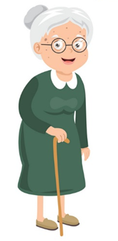
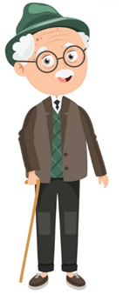






Slide 4


Unit 14
What does he look like?
Lesson 1

Slide 5
VOCABULARY

Slide 6

Vocabulary
tall
short
/tɔːl/
/ʃɔːrt/

Slide 7
Vocabulary
old
young
/əʊld/
/jʌŋ/

Slide 8
Vocabulary
slim
/slɪm/

Slide 9
Vocabulary
old
young
tall
short
slim

Slide 10







Click nút PLAY 2 lần để chơi
PLAY
PLAY

Slide 11
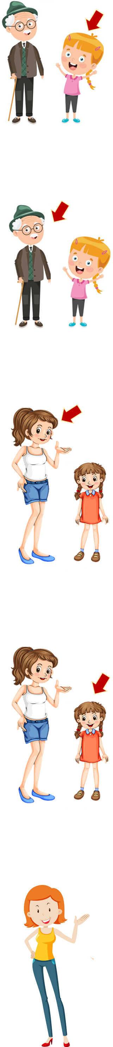

tall
Answer
Next
Notes:
Ms Huyền Phạm - 0936.082.789 – YOUTUBE: MsPham. Facebook: Dạy và học cùng công nghệ.

Slide 12
old
Answer
Next
Notes:
Ms Huyền Phạm - 0936.082.789 – YOUTUBE: MsPham. Facebook: Dạy và học cùng công nghệ.

Slide 13
young
Answer
Next
Notes:
Ms Huyền Phạm - 0936.082.789 – YOUTUBE: MsPham. Facebook: Dạy và học cùng công nghệ.

Slide 14
short
Answer
Next
Notes:
Ms Huyền Phạm - 0936.082.789 – YOUTUBE: MsPham. Facebook: Dạy và học cùng công nghệ.

Slide 15
slim
Answer
Next
Notes:
Ms Huyền Phạm - 0936.082.789 – YOUTUBE: MsPham. Facebook: Dạy và học cùng công nghệ.

Slide 16
old
Answer
Next
Notes:
Ms Huyền Phạm - 0936.082.789 – YOUTUBE: MsPham. Facebook: Dạy và học cùng công nghệ.

Slide 17
tall
Answer
Next
Notes:
Ms Huyền Phạm - 0936.082.789 – YOUTUBE: MsPham. Facebook: Dạy và học cùng công nghệ.

Slide 18
short
Answer
Next
Notes:
Ms Huyền Phạm - 0936.082.789 – YOUTUBE: MsPham. Facebook: Dạy và học cùng công nghệ.

Slide 19
thin
Answer
Next
Notes:
Ms Huyền Phạm - 0936.082.789 – YOUTUBE: MsPham. Facebook: Dạy và học cùng công nghệ.

Slide 20
young
Answer
Next
Notes:
Ms Huyền Phạm - 0936.082.789 – YOUTUBE: MsPham. Facebook: Dạy và học cùng công nghệ.

Slide 21
short
Answer
Next
Notes:
Ms Huyền Phạm - 0936.082.789 – YOUTUBE: MsPham. Facebook: Dạy và học cùng công nghệ.

Slide 22
tall
Answer
Next
Notes:
Ms Huyền Phạm - 0936.082.789 – YOUTUBE: MsPham. Facebook: Dạy và học cùng công nghệ.

Slide 23
young
Answer
Next
Notes:
Ms Huyền Phạm - 0936.082.789 – YOUTUBE: MsPham. Facebook: Dạy và học cùng công nghệ.

Slide 24
slim
Answer
Next
Notes:
Ms Huyền Phạm - 0936.082.789 – YOUTUBE: MsPham. Facebook: Dạy và học cùng công nghệ.

Slide 25
old
Answer
Next
Notes:
Ms Huyền Phạm - 0936.082.789 – YOUTUBE: MsPham. Facebook: Dạy và học cùng công nghệ.

Slide 26
Good job!
EXIT
Notes:
Ms Huyền Phạm - 0936.082.789 – YOUTUBE: MsPham. Facebook: Dạy và học cùng công nghệ.

Slide 27
GRAMMAR

Slide 28
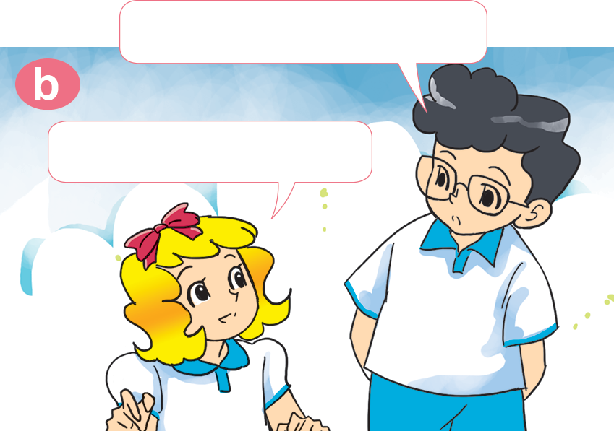

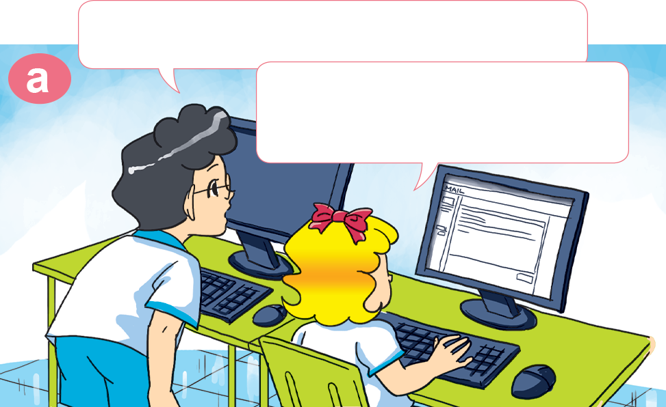

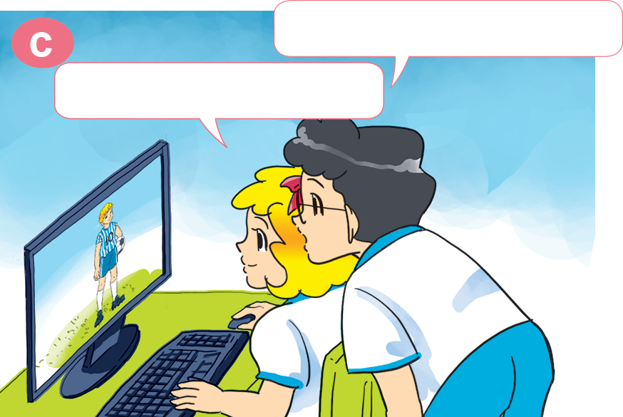
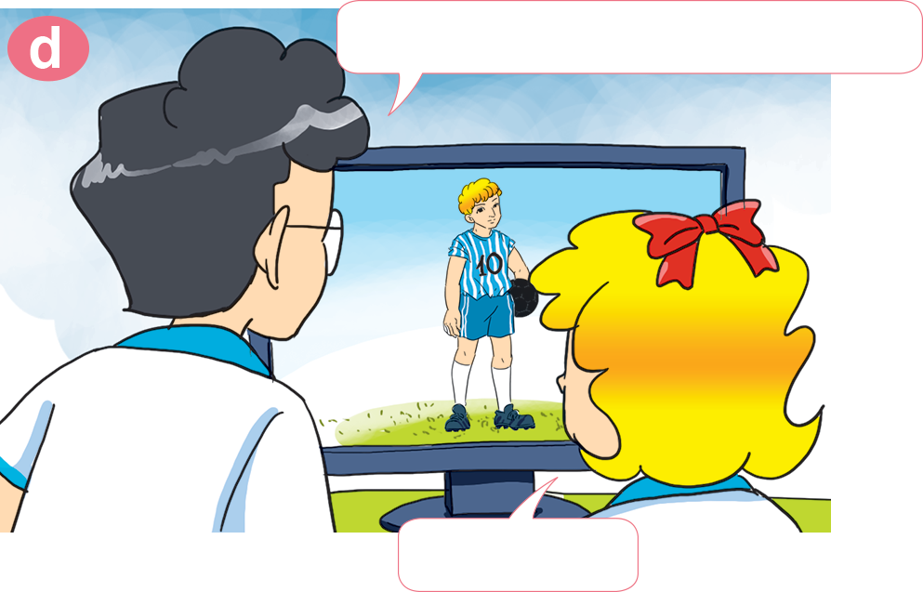
1. Look, listen and repeat.
Where is he now?
What are you doing, Linda?
l'm writing an e-mail to my brother.
He's in England.
What does he do?
What does he look like?
He's a footballer.
He's tall.

Slide 29
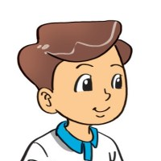

2. Point and say
What does she look like?
She's ____________.
slim

Slide 30
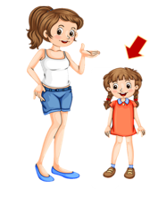
2. Point and say
What does she look like?
She's ____________.
short

Slide 31

2. Point and say
What does he look like?
He's ____________.
young

Slide 32
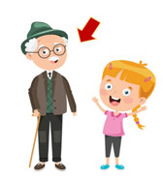
2. Point and say
What does he look like?
He's ____________.
old

Slide 33

2. Point and say
What does she look like?
She's ____________.
tall

Slide 34
What does she / he look like?
She’s / He’s ____________.
old
slim
tall
short
young

Slide 35

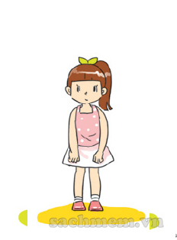
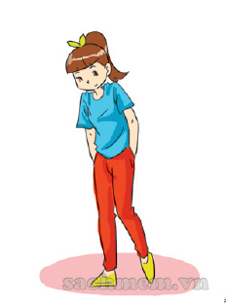




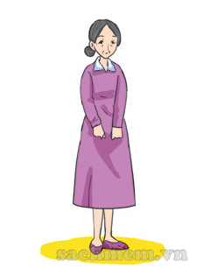
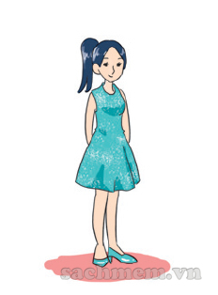
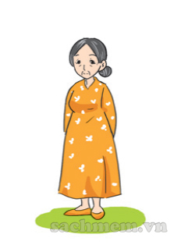

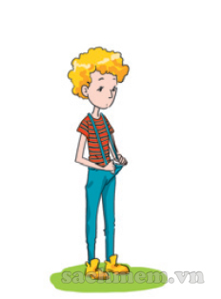
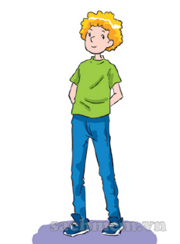
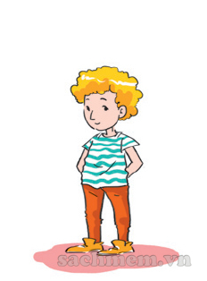

2
3
3. Listen and tick.
✔
✔
✔

Slide 36
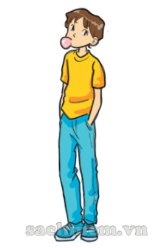

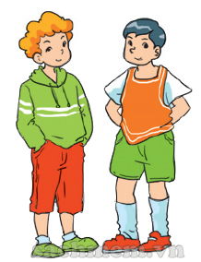
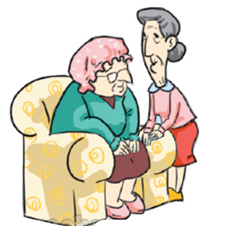
4. Look and write
does she
What ___________ look like?
_______'s ____________.
What ___________ look like?
_______'s ____________.
does he
He
tall
She
short
What ___________ look like?
_______’re ____________.
What ___________ look like?
_______’re ____________.
do they
do they
They
young
They
old

Slide 37





1
1
ant
2
mouse
3
elephant
4
dog
5
fish
6
iguana
7
hen
8
pet
9
Notes:
Ms Huyền Phạm - 0936.082.789 – YOUTUBE: MsPham. Facebook: Dạy và học cùng công nghệ.

Slide 38


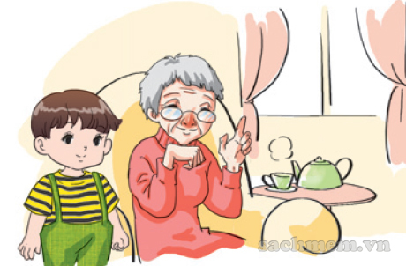


Question
1
2
3
4
5
6
7
8
9
10
The boy is ________ and the grandmother is old.
Time’s up
young
Answer
Back
Notes:
Ms Huyền Phạm - 0936.082.789 – YOUTUBE: MsPham. Facebook: Dạy và học cùng công nghệ.

Slide 39

Question
The sister is tall
and the brother is _______.
1
2
3
4
5
6
7
8
9
10
Time’s up
short
Answer
Back
Notes:
Ms Huyền Phạm - 0936.082.789 – YOUTUBE: MsPham. Facebook: Dạy và học cùng công nghệ.

Slide 40
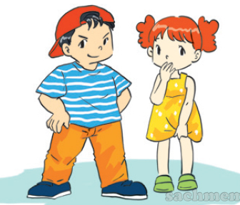
Question
He is big and she is ______.
1
2
3
4
5
6
7
8
9
10
Time’s up
Small
Answer
Back
Notes:
Ms Huyền Phạm - 0936.082.789 – YOUTUBE: MsPham. Facebook: Dạy và học cùng công nghệ.

Slide 41
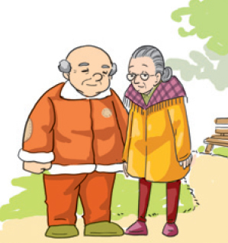
Question
My grandparents are ______.
1
2
3
4
5
6
7
8
9
10
Time’s up
old
Answer
Back
Notes:
Ms Huyền Phạm - 0936.082.789 – YOUTUBE: MsPham. Facebook: Dạy và học cùng công nghệ.

Slide 42
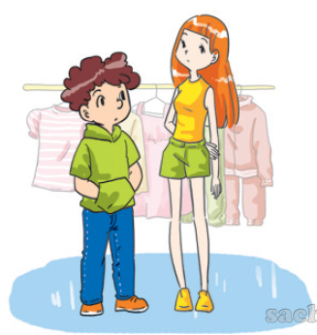
Question
The girl is ______.
1
2
3
4
5
6
7
8
9
10
Time’s up
slim
Answer
Back
Notes:
Ms Huyền Phạm - 0936.082.789 – YOUTUBE: MsPham. Facebook: Dạy và học cùng công nghệ.

Slide 43
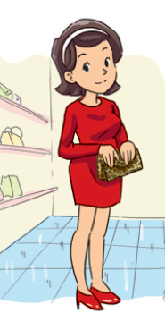
Question
What does her mother look like?
a. She's old.
b. She's young.
1
2
3
4
5
6
7
8
9
10
Time’s up
b. She's young.
Answer
Back
Notes:
Ms Huyền Phạm - 0936.082.789 – YOUTUBE: MsPham. Facebook: Dạy và học cùng công nghệ.

Slide 44
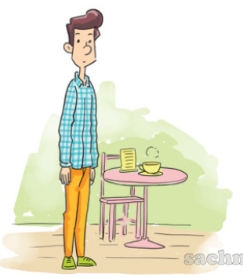
Question
What does her father look like?
a. He's short.
b. He's slim.
1
2
3
4
5
6
7
8
9
10
Time’s up
b. He's slim.
Answer
Back
Notes:
Ms Huyền Phạm - 0936.082.789 – YOUTUBE: MsPham. Facebook: Dạy và học cùng công nghệ.

Slide 45
Question
1
2
3
4
5
6
7
8
9
10
Time’s up
does
What do / does her father look like?
He's tall.
Answer
Back
Notes:
Ms Huyền Phạm - 0936.082.789 – YOUTUBE: MsPham. Facebook: Dạy và học cùng công nghệ.

Slide 46
Question
1
2
3
4
5
6
7
8
9
10
Time’s up
What does he look like?
________________________.
He's tall.
Answer
Back
Notes:
Ms Huyền Phạm - 0936.082.789 – YOUTUBE: MsPham. Facebook: Dạy và học cùng công nghệ.

Slide 47
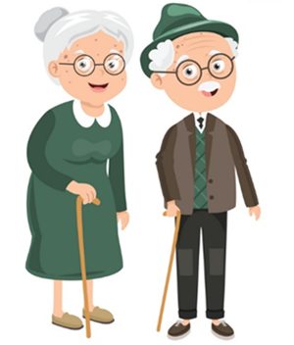
Unit 14:What does he look like?
Lesson 1 (page 24)
Vocabulary:
II. Model sentence:
young: trẻ
old: già
tall: cao
short: thấp/ngắn
slim: mảnh khảnh
strong: khỏe mạnh
thin: gầy/ mỏng
thick: mập/ dày
*Hỏi và trả lời về ngoại hình của ai đó:
What does he/ she look like?
He’s/ She's ____________.
Ex:
1. What does she look like?
She’s old.
2. What does he look like?
He’s tall.

